Slide 1

VELAMMAL ENGINEERING COLLEGE: CHENNAI 600 066
DEPARTMENT OF ELECTRONICS AND INSTRUMENTATION ENGINEERING
“Design of River Waste Collector Machine”
A MINI PROTECT REPORT
Submitted By
ARUN KUMAR.K II YEAR
HARISH.P II YEAR
of
BACHELOR OF ENGINEERING
IN
ELECTRONICS AND INSTRUMENTATION ENGINEERING
JUNE 2022
VELLAMAL ENGINEERING COLLEGE 600 066

Slide 2
BONAFIED CERTIFICATE
Certified that this Mini project report “ Design of River Waste Collector Machine”
is bonafide work of “ ARUNKUMAR.K ,HARISH P” who carried out the Mini Project under my supervision.
Dr.z.Brijet
HEAD OF THE DEPARTMENT
Electronics and instrumentation
Engineering,
Vellammal Engineering College,
Surapet,Chennai-66

Slide 3
Index
CHAPTER NO | TITLE | PAGE NO
 | ABSTRACT | 4
1. | INTRODUCTION | 5
1.1 | Introduction | 5
2. | BLOCK DIAGRAM | 6
2.1 | Block Diagram | 6
2.2 | HARDWARE USED | 7
2.2.1 | Power distribution module | 7
2.2.2 | ESP8266 Microcontroller | 7
2.2.3 | 11.5 V Battery | 8
2.2.4 | Motor driver L298 | 8
2.2.5 | Gear DC Motor | 9
3. | SOFTWARE | 10
3.1. | Software used | 10
3.1.1 | NODE MCU | 10
3.1.2 | Programming IDE | 10
4. | RESULT AND DISCUSSION | 11
5. | APPENDIX | 12
6. | REFERENCES | 18

Slide 4
ABSTRACT
This project emphasis on design of the river waste collection. Trillions of pieces of plastic currently pollute the seas, rivers, lakes, ocean harming sea life, contaminating ecosystems and making a mess on beaches. Thus It's important to clean up the plastic in the water, but nobody knows how best to do so yet. These days practically all the assembling procedure is being automized so as to convey the items at a quicker rate. Automation plays an important role in mass production. In this venture we have manufactured the remote worked waterway cleaning machine. Prime objective of our project is to collect all the wastes which are found floating on water bodies and to minimize labor work. These are done by using a hardware prototype and by using an Microcontroller for controlling all parts of a machine by using an smart phone by using Wi-Fi or Bluetooth. We have attempted to meet every one of the destinations to this item fruitful with the end goal that our item gets propelled in the market.
Index Terms: - Microcontroller, Motors, Conveyor Belts, Battery, Motor Driver Controller.

Slide 5
CHAPTER 1
INTRODUCTION
1.1. INTRODUCTION
The "Stream Waste authority machine" utilized in that places where there is squander flotsam and jetsam in the water body which are to be expelled. This machine is consists of waterwheel driven conveyer mechanism which collect & remove the wastage, garbage & plastic wastages from water bodies.
This additionally lessen the challenges which we face when gathering of flotsam and jetsam happen. A machine will lift the waste surface flotsam and jetsam from the water bodies, this will eventually result in decrease of water contamination and in conclusion the sea-going creature's demise to these issues will water. The use of this project will be made in rivers, ponds and other water bodies to clean the surface water debris from bodies.

Slide 6
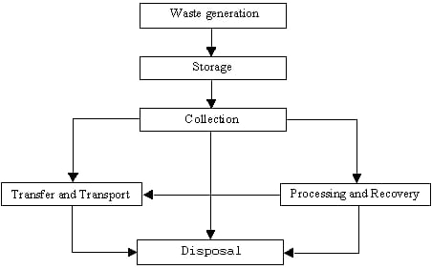
2.1 BLOCK DIAGRAM
Figure 2.1 describes the detailed working of smart dustbin block diagram. The internal c Components are IR transmitter and receiver with relay-based motor to activate the lid movement
BLOCK DIAGRAM

Slide 7
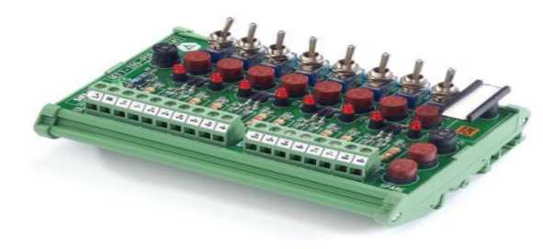
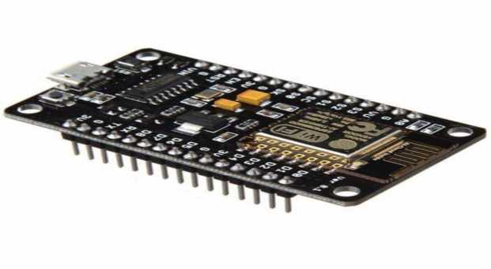
2.2HARDWARE USED:
2.2.1. POWER DISTRIBUTION MODULE:
A power distribution module (PDM) is used to provide electrical power from a main power source to a variety of vehicle or equipment peripherals which may require the following: Compact form factors when reliability and safety are factors.
Figure 2.2 POWER DISTRIBUTION MODULE
2.2.2. ESP 8266 MICROCONTROLLER:
The ESP8266 WiFi Module is a self contained SOC with integrated TCP/IP protocol stack that can give any microcontroller access to your WiFi network. The
ESP8266 is capable of either hosting an application or offloading all Wi-Fi networking functions from another application processor
Figure 2.3 ESP 8266 MICROCONTROLLER

Slide 8
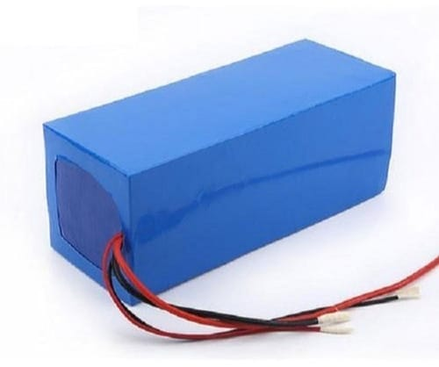
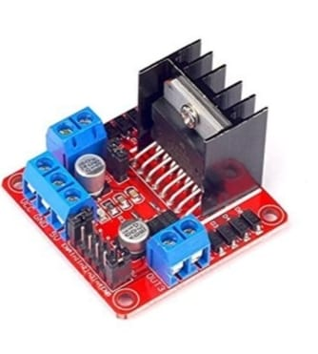
2.2.3:11.5 V BATTERY:
Usage/Application is Solar Lantem,Battery Capacity is 30 Ah and Battery used are lithium ion battery
Figure 2.4 11.5 V BATTEY 2.2.4:MOTOR DRIVER L298:
The L298 is an integrated monolithic circuit in a 15-lead Multiwatt and PowerSO20 packages. It is a high voltage, high current dual full-bridge driver designed to accept standard TTL logic levels and drive inductive loads such as relays, solenoids, DC and stepping motors
Figure 2.5 MOTOR DRIVER L298

Slide 9
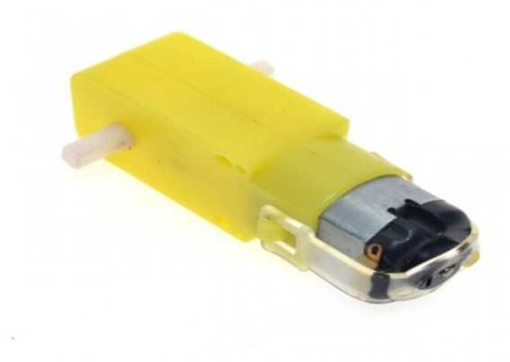
2.2.5:GEAR DC MOTOR:
A gear motor is an all-in-one combination of a motor and gearbox. The addition of a gear head to a motor reduces the speed while increasing the torque output.
Figure 2.6 GEAR DC MOTOR

Slide 10
CHAPTER 3
SOFTWARE
3.1 SOFTWARE USED
3.1.1. NODE MCU:
Node MCU is an open source IOT Platform.It include firmware which runs on the ESP8266 WIFI SOC from espress if systems and hardware,which is based on the ESP-12 module.The term “Node MCU ‘ by default refers to the firmware rather than the dev kits.The firmware uses the Lua Scripting language.
3.1.2. IDE (Integrated Development Environment)
Processing is an open source programming language and integrated development environment (IDE) built for the electronic arts, new media art, and visual design communities with the purpose of teaching the fundamentals of computer programming in a visual context, and to serve as the foundation for electronic sketchbooks.

Slide 11
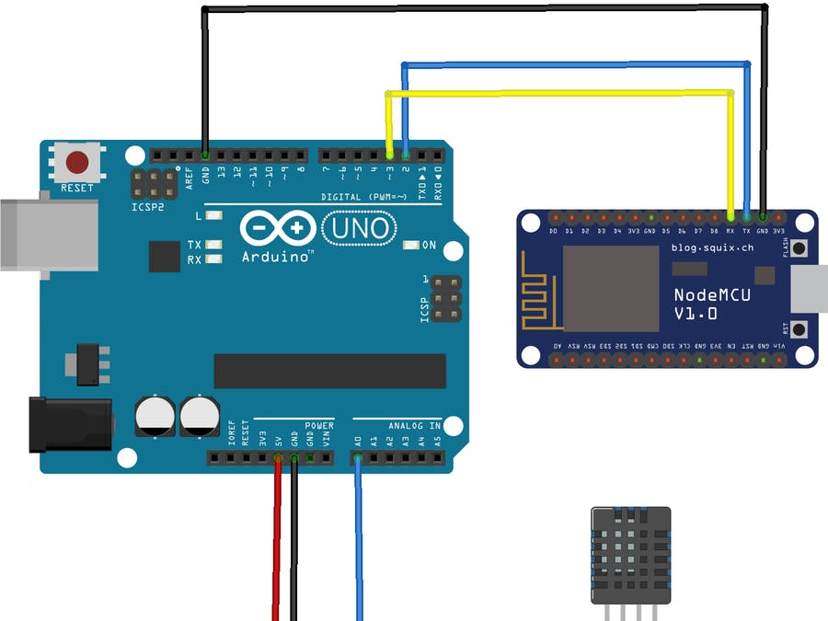
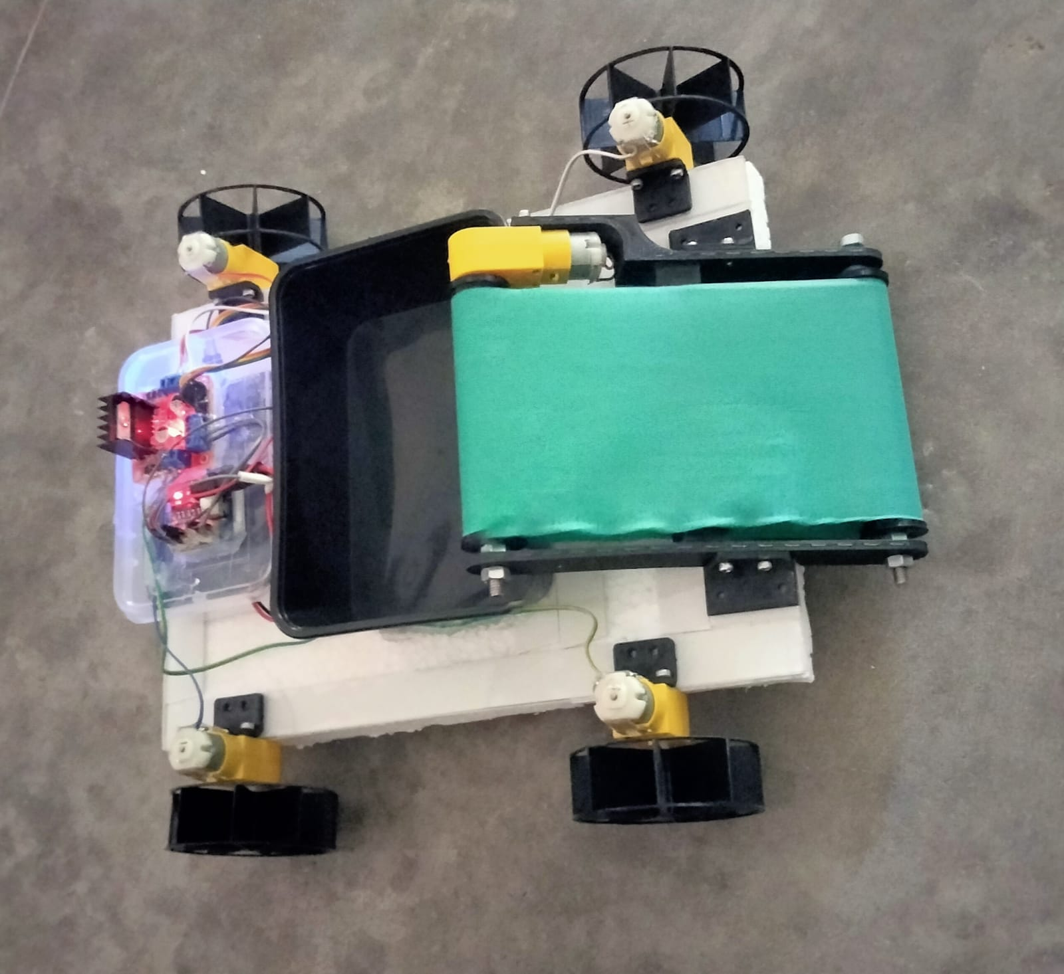
CHAPTER 4
RESULTS AND DISCUSSION
Figure 4.1 shows the connection diagram of the sensors with Node MCU
Figure 4.1 connection diagram of NODE MCU
Figure 4.2 Prototype model

Slide 12
5.NODE MCU(PROGRAMMING CODE):
# include <ESP8266WiFi.h>
#include <WiFiClient.h>
#include <ESP8266WebServer.h>
String command; //String to store
app command state.
int speedCar = 800; // 400 – 1023
int speed_Coeff = 3;
const char* ssid = "Make DIY";
ESP8266WebServer server(80);
{
void setup()
{
pinMode(ENA, OUTPUT);
pinMode(ENB, OUTPUT);
pinMode(IN_1, OUTPUT)
pinMode(IN_2, OUTPUT);
pinMode(IN_3, OUTPUT);
pinMode(IN_4, OUTPUT);
Serial.begin(115200); //Connecting WiFi
WiFi.mode(WIFI_AP);
WiFi.softAP(ssid);
IPAddress myIP = WiFi.softAPIP();
Serial.print("AP IP address: ");

Slide 13
Serial.println(myIP); // Starting WEB-server
server.on ( "/", HTTP_handleRoot );
server.onNotFound ( HTTP_handleRoot );
server.begin();
}
void goAhead()
digitalWrite(IN_1, LOW);
digitalWrite(IN_2, HIGH);
analogWrite(ENA, speedCar);
digitalWrite(IN_3, LOW);
digitalWrite(IN_4, HIGH);
analogWrite(ENB, speedCar);
}
Void goBack(){
digitalWrite(IN_1, LOW);
digitalWrite(IN_2, HIGH);
analogWrite(ENA, speedCar);
digitalWrite(IN_3, LOW);
digitalWrite(IN_4, HIGH);
analogWrite(ENB, speedCar);
}
void goRight(){
digitalWrite(IN_1, HIGH);
.

Slide 14
analogWrite(ENA, speedCar);
digitalWrite(IN_3, HIGH);
digitalWrite(IN_4, LOW); digitalWrite(IN_2, LOW);
analogWrite(ENA, speedCar);
digitalWrite(IN_3, LOW);
digitalWrite(IN_4, HIGH);
analogWrite(ENB, speedCar); }
void goLeft()
{
digitalWrite(IN_1, LOW);
digitalWrite(IN_2, HIGH);
analogWrite(ENB, speedCar);
}
void goAheadRight(){
digitalWrite(IN_1, LOW);
digitalWrite(IN_2, HIGH);
analogWrite(ENA, speedCar/speed_Coeff);
digitalWrite(IN_3, LOW);

Slide 15
DigitalWrite(IN_4, HIGH);
analogWrite(ENB, speedCar);
}
void goAheadLeft()
{
digitalWrite(IN_1, LOW);
digitalWrite(IN_2, HIGH);
analogWrite(ENA, speedCar);
digitalWrite(IN_3, LOW);
digitalWrite(IN_4, HIGH);
analogWrite(ENB, speedCar/speed_Coeff);
}
void goBackRight(){
digitalWrite(IN_1, HIGH);
digitalWrite(IN_2, LOW);
analogWrite(ENA, speedCar/speed_Coeff);
digitalWrite(IN_3, HIGH);
digitalWrite(IN_4, LOW);

Slide 16
analogWrite(ENB, speedCar);
}
void goBackLeft(){
digitalWrite(IN_1, HIGH);
digitalWrite(IN_2, LOW);
analogWrite(ENA, speedCar);
digitalWrite(IN_3, HIGH);
digitalWrite(IN_4, LOW);
analogWrite(ENB, speedCar/speed_Coeff);
}
void stopRobot(){
digitalWrite(IN_1, LOW);
digitalWrite(IN_2, LOW);
analogWrite(ENA, speedCar);
digitalWrite(IN_3, LOW);
digitalWrite(IN_4, LOW);
analogWrite(ENB, speedCar);
}
void loop() {
server.handleClient();
command = server.arg("State");
if (command == "F") goAhead();
else if (command == "B") goBack();
else if (command == "L") goLeft();
else if (command == "R") goRight();
else if (command == "I") goAheadRight();
else if (command == "G") goAheadLeft();
else if (command == "J") goBackRight();
else if (command == "H") goBackLeft();
else if (command == "0") speedCar = 400;
else if (command == "1") speedCar = 470;
else if (command == "2") speedCar = 540;
else if (command == "3") speedCar = 610;
else if (command == "4") speedCar = 680;
else if (command == "5") speedCar = 750;

Slide 17
else if (command == "6") speedCar = 820;
else if (command == "7") speedCar = 890;
else if (command == "8") speedCar = 960;
else if (command == "9") speedCar = 1023;
else if (command == "S") stopRobot();
}
void HTTP_handleRoot(void)
{
if( server.hasArg("State") )
{
Serial.println(server.arg("State"));
}
server.send ( 200, "text/html", "" );
delay(1);
}

Slide 18
6.REFERENCE:
➢ Madhavi N.Wagh,2Kashinath Munde. “Design and Analysis of River Water Cleaning Machine”
IJSDR Volume 3, Issue 7, ISSN: 2455-2631.[JULY 2018].
➢ http://www.boatdesign.net/forums/props/prop-thrust-calculation-38283.html
➢ Mr.Abhijeet.M. Ballade, Mr. Vishal.S. Garde, Mr.Akash.S. Mr.Pranav.V.Boob and Lahane, “Design
& fabrication of river cleaning system”, IJMTER Volume 04, Issue 2, [February– 2017] ISSN:2349–9745

